Slide 1
Simulation Plot II
ABCD
LL.4
100 Wiederholungen
Replikate
b=3, c=0, d=130
Varianz = 10
8.2.2013
JN

Slide 2
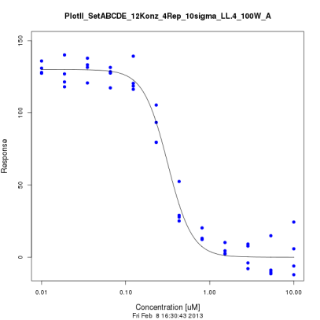
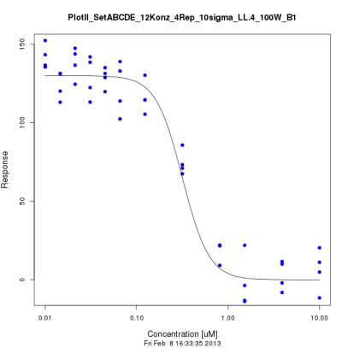
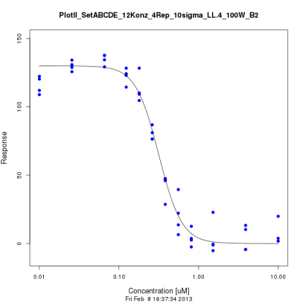
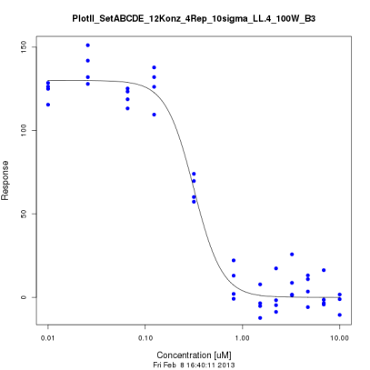
B) Position of the concentrations
PlotII A
BMCtrue | 0,152027
mean BMCcalc | 0,154066
mean Std | 0,016255
mean Delta | 0,017069
mean Anz. Sigma | 1,087176
count in CI | 0,75
count Modell | 0,39
count fails | 0
PlotII B1
BMCtrue | 0,151798
mean BMCcalc | 0,159971
mean Std | 0,027103
mean Delta | 0,028641
mean Anz. Sigma | 1,117347
count in CI | 0,75
count Modell | 0,48
count fails | 0
PlotII B2
BMCtrue | 0,152027
mean BMCcalc | 0,15058
mean Std | 0,013764
mean Delta | 0,016997
mean Anz. Sigma | 1,276405
count in CI | 0,66
count Modell | 0,56
count fails | 0
PlotII B3
BMCtrue | 0,152027
mean BMCcalc | 0,160656
mean Std | 0,026382
mean Delta | 0,027963
mean Anz. Sigma | 1,10951
count in CI | 0,78
count Modell | 0,41
count fails | 0
JN

Slide 3
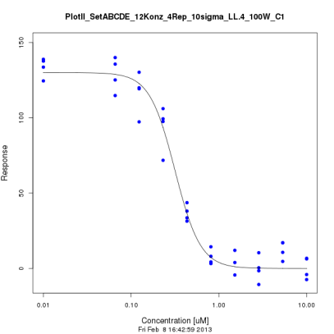
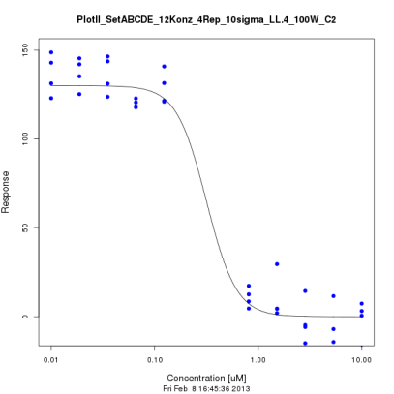
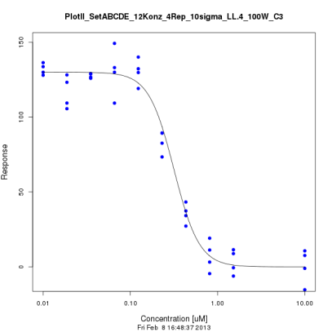
C) Missing concentrations
PlotII A
BMCtrue | 0,152027
mean BMCcalc | 0,154066
mean Std | 0,016255
mean Delta | 0,017069
mean Anz. Sigma | 1,087176
count in CI | 0,75
count Modell | 0,39
count fails | 0
PlotII C1
BMCtrue | 0,152027
mean BMCcalc | 0,153926
mean Std | 0,016939
mean Delta | 0,020362
mean Anz. Sigma | 1,315582
count in CI | 0,67
count Modell | 0,43
count fails | 0
PlotII C2
BMCtrue | 0,152027
mean BMCcalc | 0,172951
mean Std | 0,130554
mean Delta | 0,046989
mean Anz. Sigma | 0,945713
count in CI | 0,79
count Modell | 0,09
count fails | 0
PlotII C3
BMCtrue | 0,152013
mean BMCcalc | 0,153594
mean Std | 0,016126
mean Delta | 0,018439
mean Anz. Sigma | 1,213089
count in CI | 0,72
count Modell | 0,41
count fails | 0
JN

Slide 4
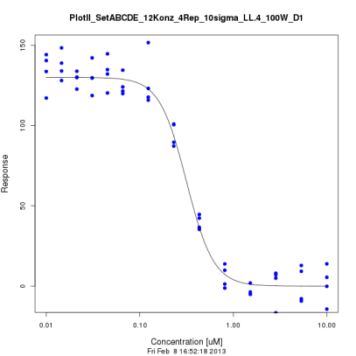
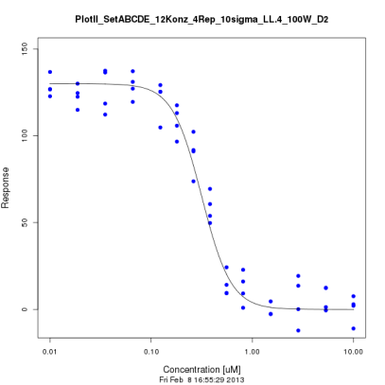
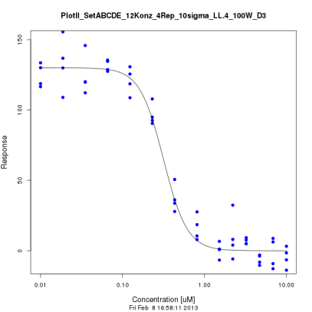
D) Additional concentrations
PlotII A
BMCtrue | 0,152027
mean BMCcalc | 0,154066
mean Std | 0,016255
mean Delta | 0,017069
mean Anz. Sigma | 1,087176
count in CI | 0,75
count Modell | 0,39
count fails | 0
PlotII D1
BMCtrue | 0,152027
mean BMCcalc | 0,152385
mean Std | 0,015428
mean Delta | 0,015983
mean Anz. Sigma | 1,110059
count in CI | 0,75
count Modell | 0,5
count fails | 0
PlotII D2
BMCtrue | 0,152026
mean BMCcalc | 0,149394
mean Std | 0,013314
mean Delta | 0,016141
mean Anz. Sigma | 1,242344
count in CI | 0,68
count Modell | 0,5
count fails | 0
PlotII D3
BMCtrue | 0,152027
mean BMCcalc | 0,151496
mean Std | 0,016127
mean Delta | 0,019065
mean Anz. Sigma | 1,274325
count in CI | 0,7
count Modell | 0,39
count fails | 0
JN

Slide 5
Simulation Plot II
ABCD
W1.4
100 Wiederholungen
Replikate
b=3, c=0, d=130
Varianz = 10
11.2.2013
JN

Slide 6
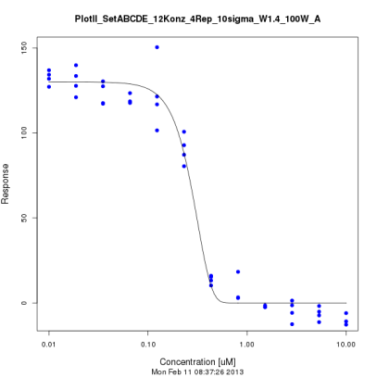
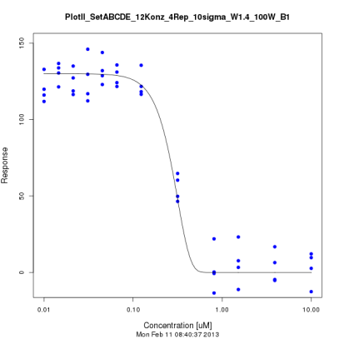
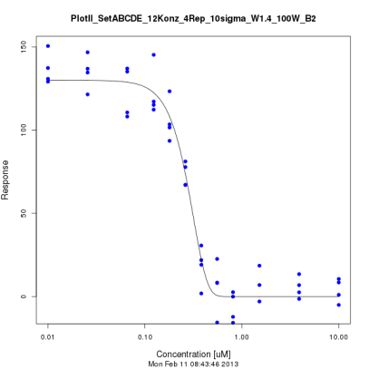
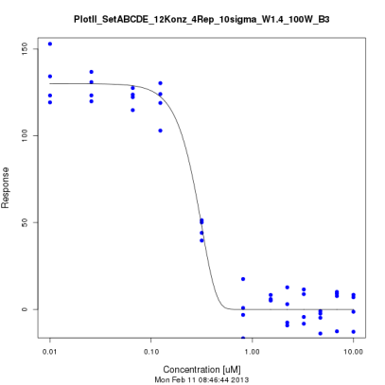
B) Position of the concentrations
PlotII A
BMCtrue | 0,149357
mean BMCcalc | 0,158641
mean Std | 0,014173
mean Delta | 0,018199
mean Anz. Sigma | 1,501245
count in CI | 0,75
count Modell | 0,74
count fails | 0
BMCtrue | 0,149357
mean BMCcalc | 0,153318
mean Std | 0,051113
mean Delta | 0,026343
mean Anz. Sigma | 0,802763
count in CI | 0,9
count Modell | 0,58
count fails | 0
PlotII B2
BMCtrue | 0,149357
mean BMCcalc | 0,154955
mean Std | 0,012924
mean Delta | 0,014432
mean Anz. Sigma | 1,189542
count in CI | 0,79
count Modell | 0,74
count fails | 0
PlotII B3
BMCtrue | 0,149358
mean BMCcalc | 0,153111
mean Std | 0,045873
mean Delta | 0,02462
mean Anz. Sigma | 0,699636
count in CI | 0,91
count Modell | 0,61
count fails | 0
JN

Slide 7
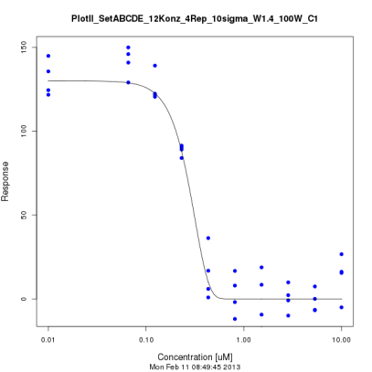
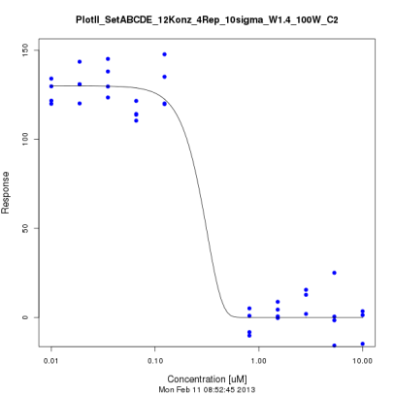
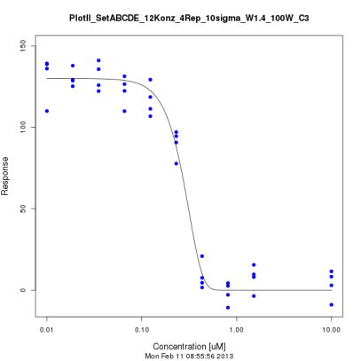
C) Missing concentrations
PlotII A
BMCtrue | 0,149357
mean BMCcalc | 0,158641
mean Std | 0,014173
mean Delta | 0,018199
mean Anz. Sigma | 1,501245
count in CI | 0,75
count Modell | 0,74
count fails | 0
PlotII C1
BMCtrue | 0,149357
mean BMCcalc | 0,159932
mean Std | 0,014869
mean Delta | 0,020214
mean Anz. Sigma | 1,625287
count in CI | 0,73
count Modell | 0,69
count fails | 0
PlotII C2
BMCtrue | 0,149423
mean BMCcalc | 0,172663
mean Std | 4,368959
mean Delta | 0,048805
mean Anz. Sigma | 1,081406
count in CI | 0,8
count Modell | 0,53
count fails | 0,01
PlotII C3
BMCtrue | 0,149357
mean BMCcalc | 0,160575
mean Std | 0,013615
mean Delta | 0,019266
mean Anz. Sigma | 1,663153
count in CI | 0,66
count Modell | 0,65
count fails | 0
JN

Slide 8
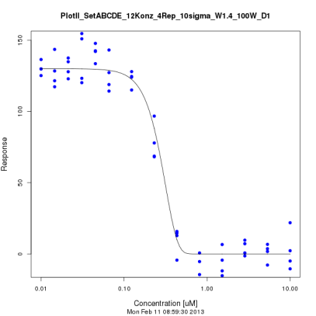
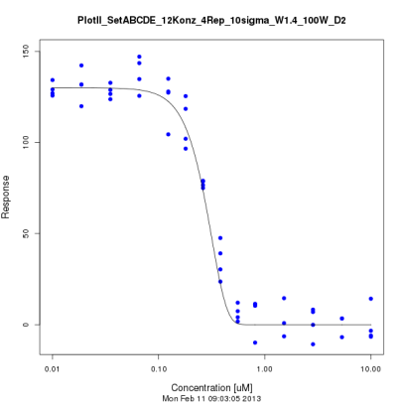
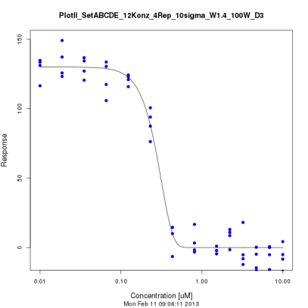
D) Additional concentrations
PlotII A
BMCtrue | 0,149357
mean BMCcalc | 0,158641
mean Std | 0,014173
mean Delta | 0,018199
mean Anz. Sigma | 1,501245
count in CI | 0,75
count Modell | 0,74
count fails | 0
PlotII D1
BMCtrue | 0,149357
mean BMCcalc | 0,163044
mean Std | 0,012714
mean Delta | 0,019731
mean Anz. Sigma | 1,831918
count in CI | 0,65
count Modell | 0,61
count fails | 0,01
PlotII D2
BMCtrue | 0,149357
mean BMCcalc | 0,152166
mean Std | 0,012333
mean Delta | 0,01208
mean Anz. Sigma | 1,004576
count in CI | 0,83
count Modell | 0,78
count fails | 0
PlotII D3
BMCtrue | 0,149357
mean BMCcalc | 0,160967
mean Std | 0,013932
mean Delta | 0,018101
mean Anz. Sigma | 1,496994
count in CI | 0,72
count Modell | 0,69
count fails | 0
JN

Slide 9
Simulation Plot II
ABCD
EXD.3
100 Wiederholungen
Replikate
c=0, d=130
Varianz = 10
11.2.2013
JN

Slide 10
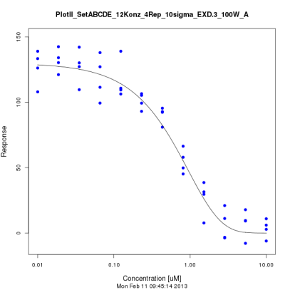
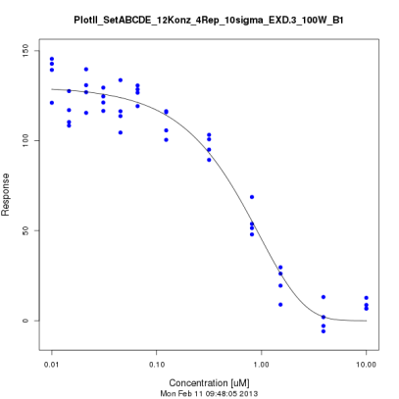
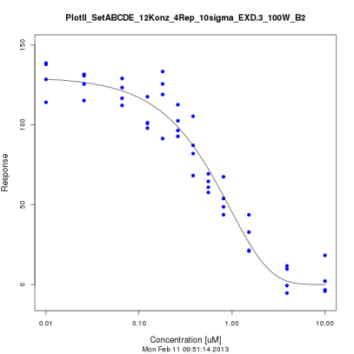
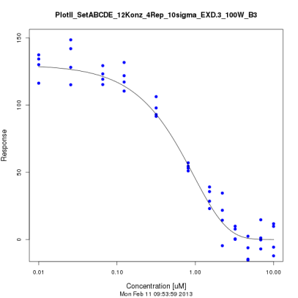
B) Position of the concentrations
PlotII A
BMCtrue | 0,099954
mean BMCcalc | 0,115032
mean Std | 0,012603
mean Delta | 0,023447
mean Anz. Sigma | 1,231491
count in CI | 0,78
count Modell | 0,72
count fails | 0
PlotII B1
BMCtrue | 0,099954
mean BMCcalc | 0,105611
mean Std | 0,012675
mean Delta | 0,01901
mean Anz. Sigma | 1,209671
count in CI | 0,72
count Modell | 0,75
count fails | 0
PlotII B2
BMCtrue | 0,099954
mean BMCcalc | 0,112696
mean Std | 0,01295
mean Delta | 0,021744
mean Anz. Sigma | 1,30307
count in CI | 0,73
count Modell | 0,65
count fails | 0
PlotII B3
BMCtrue | 0,099954
mean BMCcalc | 0,119242
mean Std | 0,014251
mean Delta | 0,026121
mean Anz. Sigma | 1,333858
count in CI | 0,7
count Modell | 0,69
count fails | 0
JN

Slide 11
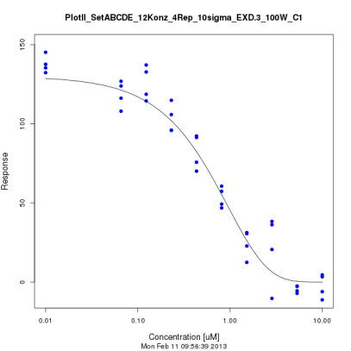
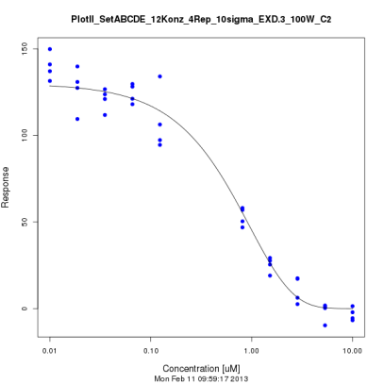
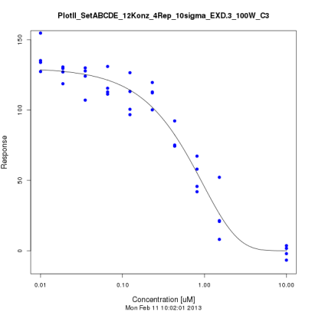
C) Missing concentrations
PlotII A
BMCtrue | 0,099954
mean BMCcalc | 0,115032
mean Std | 0,012603
mean Delta | 0,023447
mean Anz. Sigma | 1,231491
count in CI | 0,78
count Modell | 0,72
count fails | 0
PlotII C1
BMCtrue | 0,099954
mean BMCcalc | 0,115716
mean Std | 0,013556
mean Delta | 0,019408
mean Anz. Sigma | 1,040932
count in CI | 0,81
count Modell | 0,76
count fails | 0
PlotII C2
BMCtrue | 0,099954
mean BMCcalc | 0,12081
mean Std | 0,020113
mean Delta | 0,028733
mean Anz. Sigma | 1,046357
count in CI | 0,81
count Modell | 0,7
count fails | 0
PlotII C3
BMCtrue | 0,099954
mean BMCcalc | 0,106489
mean Std | 0,01298
mean Delta | 0,018078
mean Anz. Sigma | 1,10109
count in CI | 0,78
count Modell | 0,71
count fails | 0
JN

Slide 12
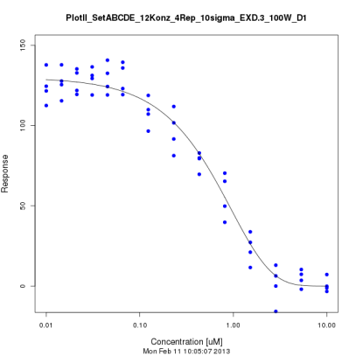
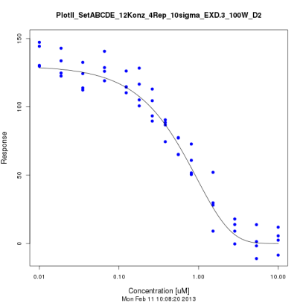
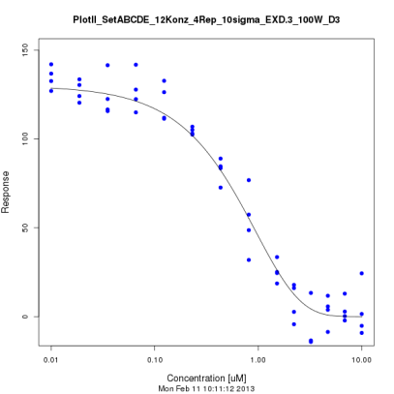
D) Additional concentrations
PlotII A
BMCtrue | 0,099954
mean BMCcalc | 0,115032
mean Std | 0,012603
mean Delta | 0,023447
mean Anz. Sigma | 1,231491
count in CI | 0,78
count Modell | 0,72
count fails | 0
PlotII D1
BMCtrue | 0,099954
mean BMCcalc | 0,114362
mean Std | 0,012639
mean Delta | 0,020996
mean Anz. Sigma | 1,226166
count in CI | 0,69
count Modell | 0,68
count fails | 0
PlotII D2
BMCtrue | 0,099954
mean BMCcalc | 0,114292
mean Std | 0,012028
mean Delta | 0,023515
mean Anz. Sigma | 1,394956
count in CI | 0,7
count Modell | 0,65
count fails | 0,01
PlotII D3
BMCtrue | 0,099954
mean BMCcalc | 0,112192
mean Std | 0,011808
mean Delta | 0,020033
mean Anz. Sigma | 1,189572
count in CI | 0,7
count Modell | 0,73
count fails | 0
JN

Slide 13


